Slide 1


Unveiling Insights from Weather Data
In the conclusion of our weather analysis journey, we synthesize the key findings and uncover the invaluable insights that emerged from our in-depth exploration of weather patterns using Python and Power BI.
by Jotiba Rankhamb

Slide 2
Data Collection and Preprocessing
Diverse Data Sources
Rigorous Cleaning
Enriched Attributes
We gathered weather data from multiple repositories, including government agencies and online platforms, to create a comprehensive dataset.
We meticulously cleaned and preprocessed the data, addressing missing values, outliers, and inconsistencies to ensure data integrity.
We engineered new features from the raw data, such as weather patterns and seasonal trends, to uncover hidden insights.

Slide 3
Exploratory Data Analysis
1
Identifying Trends
2
Correlating Factors
We conducted in-depth analysis to detect long-term trends, seasonal variations, and anomalies in weather patterns.
We explored the relationships between various weather parameters, such as temperature, precipitation, and wind, to uncover interdependencies.
3
Spatial Variations
4
Uncovering Patterns
We mapped the geographical distribution of weather conditions to identify regional differences and weather hotspots.
Our analysis revealed unique weather patterns and their underlying drivers, providing valuable insights for decision-making.

Slide 4

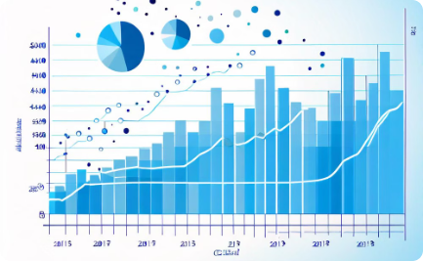

Visualizing Weather Patterns using Python
Spatial Visualizations
Temporal Analyses
Advanced Representations
We leveraged Python's powerful data visualization libraries to create interactive maps and heat maps that highlighted geographic weather patterns.
Our time-series visualizations, such as line charts and scatter plots, enabled us to uncover temporal patterns and trends in the data.
We explored innovative 3D and animated visualizations to gain a deeper understanding of the complexities within the weather data.

Slide 5




Predictive Modeling with Machine Learning
Forecasting
Extreme Event Detection
Climate Modeling
Energy Management
We developed predictive models to forecast weather conditions, enabling more accurate and reliable predictions.
Our models identified patterns that could signal the occurrence of extreme weather events, allowing for proactive preparedness.
We explored the application of machine learning to model long-term climate trends and assess the impact of environmental factors.
Our predictive models can support energy-efficient planning and resource allocation, optimizing the use of weather-dependent resources.

Slide 6




Integrating Weather Data with Power BI
Data Connectivity
Interactive Dashboards
Actionable Insights
We seamlessly connected Power BI to our curated weather dataset, enabling efficient data integration and exploration.
The Power BI platform empowered us to surface meaningful insights and facilitate data-driven decision-making for weather-related applications.
Our Power BI dashboards provided dynamic and intuitive visualizations, allowing users to quickly navigate and interpret the data.

Slide 7
Insights and Findings
Seasonal Fluctuations
Weather-Energy Nexus
Our analysis revealed distinct seasonal patterns in weather parameters, enabling better preparation for changing conditions.
We uncovered strong correlations between weather factors and energy consumption, informing more efficient energy management strategies.
Climate Change Signals
Extreme Event Prediction
Our models identified early indicators of climate change, such as temperature anomalies and precipitation shifts, informing adaptation efforts.
The predictive models we developed can anticipate the likelihood and severity of extreme weather events, supporting emergency preparedness.

Slide 8

Conclusion and Future Directions
1
Continuous Refinement
We will continue to refine our models and visualizations, incorporating new data sources and evolving our analytical approaches.
2
Expanding Applications
The insights gained from this project can be applied to diverse domains, from agriculture to urban planning and beyond.
3
Collaborative Initiatives
We aim to foster cross-disciplinary collaborations to further advance weather analysis and its impact on societal and environmental issues.

